Slide 1

American Diploma Graduation Requirements
ACIC School

Slide 2
Al Afak Al Gadeda International School
Graduation Requirements and Cumulative Average Calculations

Slide 3
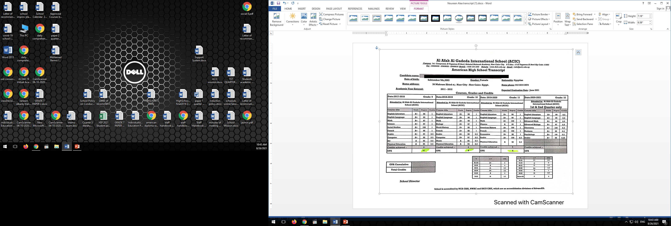
Examples for Graduation Transcripts:
Scholastic Year 2020-2021

Slide 4
How is the 40% of school grade calculated?
Score of the highest qualifying 8 subjects are selected.
Ex: 100+97+89+97+76+86+93+97 = 735
735 / 8 = 91.87
91.87 x 40% = 36.75

Slide 5
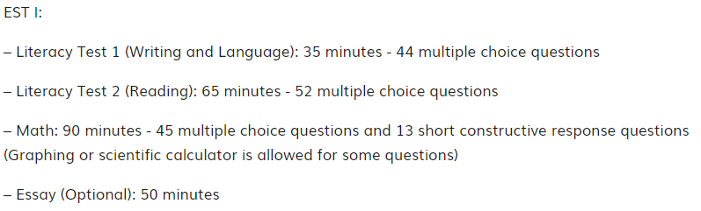
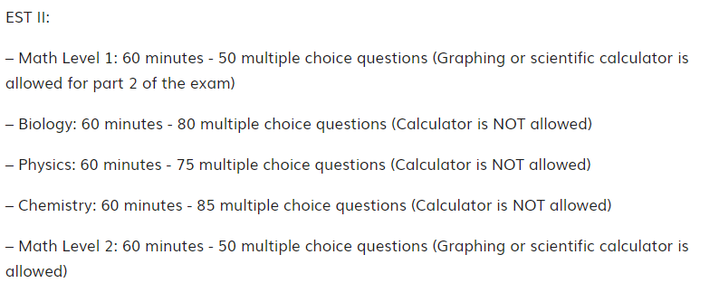
The Exams are structured as follows:

Slide 6
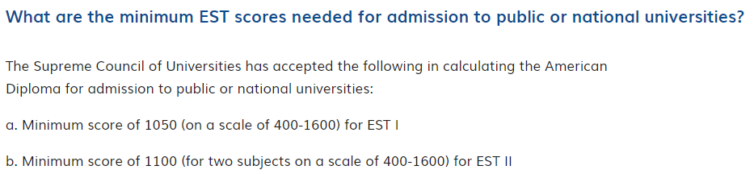

Slide 7
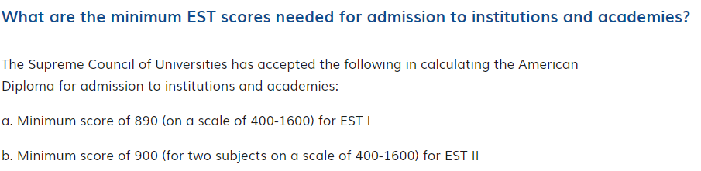
Ministry Requirements

Slide 8
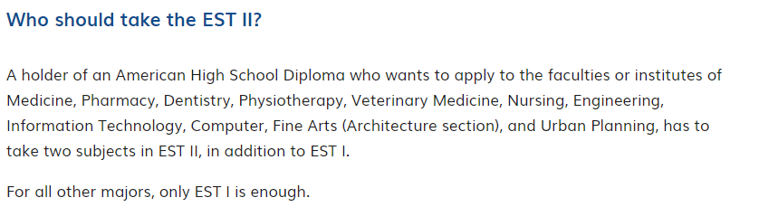

Slide 9
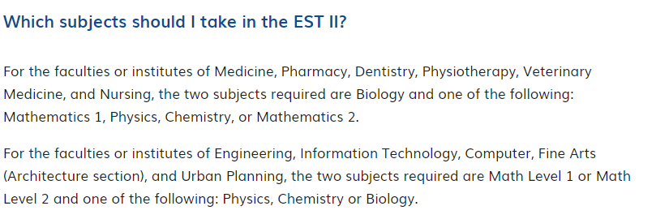
EST II Subjects

Slide 10
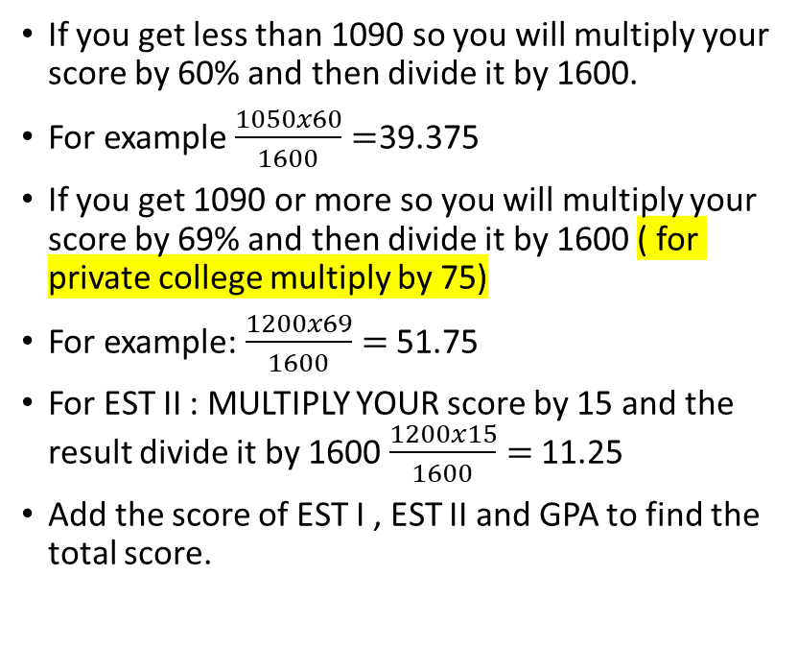
How to calculate EST score?
If you get less than 1090 so you will multiply your score by 60% and then divide it by 1600.
For example $\frac{1050x60}{1600}=$39.375
If you get 1090 or more so you will multiply your score by 69% and then divide it by 1600 ( for private college multiply by 75)
For example: $\frac{1200x69}{1600}=$ 51.75
For EST II : MULTIPLY YOUR score by 15 and the result divide it by 1600 $\frac{1200x15}{1600}=$ 11.25
Add the score of EST I , EST II and GPA to find the total score.

Slide 11
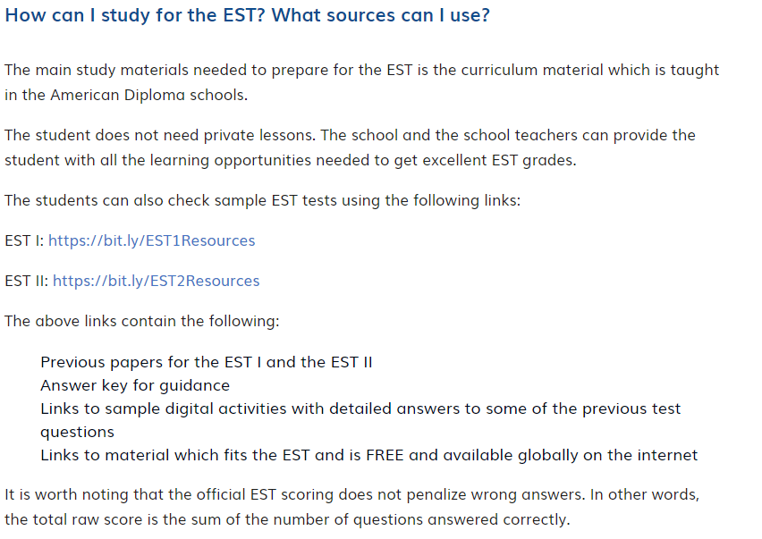

Slide 12
The EST is administered multiple times every year in January, March, May, July, October, December.
The EST website is :https://egypt.estests.com

Slide 13



For grade 11: choose between two sections For those students joining scientific colleges:
Elective (1) must be chosen.
Grade 11
School Year
Career Goal
Course : | Credits
English Language | 1
English Literature | 1
American History | 1
French/German | 1
Elective(1) Math Physics Economics/ Computer | 1 1 1
Elective(2) Math Sociology Economics | 1 1 1
Arabic | 0.5
Total Credits | 7.5
Student Signature -----------------
Parent Signature --------------------
Math
Physics
Economics or computer

Slide 14
For grade 11 choose between two sections For those students joining nonscientific colleges:
Elective (2) must be chosen.
Grade 11
School Year
Career Goal
Course : | Credits
English Language | 1
English Literature | 1
American History | 1
French/German | 1
Elective(1) Math Physics Economics/ Computer | 1 1 1
Elective(2) Math Sociology Economics | 1 1 1
Arabic | 0.5
Total Credits | 7.5
Student Signature -----------------
Parent Signature --------------------
Math
sociology
Economics

Slide 15
For grade 12 choose between two sections For those students joining art colleges:
Elective (2) must be chosen.
Grade 12
School Year
Career Goal
Course : | Credits
English Language | 1
English Literature | 1
Business | 1
Psychology | 1
Elective(1) Advanced Math Chemistry | 1 1
Elective(2) Statistics Accounting | 1 1
Arabic | 0.5
Total Credits | 6.5
Student Signature -----------------
Parent Signature --------------------
Statistics
Accounting

Slide 16
For grade 12 choose between two sections For those students joining scientific colleges:
Elective (1) must be chosen.
Grade 12
School Year
Career Goal
Course : | Credits
English Language | 1
English Literature | 1
Business | 1
Psychology | 1
Elective(1) Advanced Math Chemistry | 1 1
Elective(2) Statistics Accounting | 1 1
Arabic | 0.5
Total Credits | 6.5
Student Signature -----------------
Parent Signature --------------------
Advanced Math
Chemistry

Slide 18
ACIC School
THANK YOU

