Slide 1
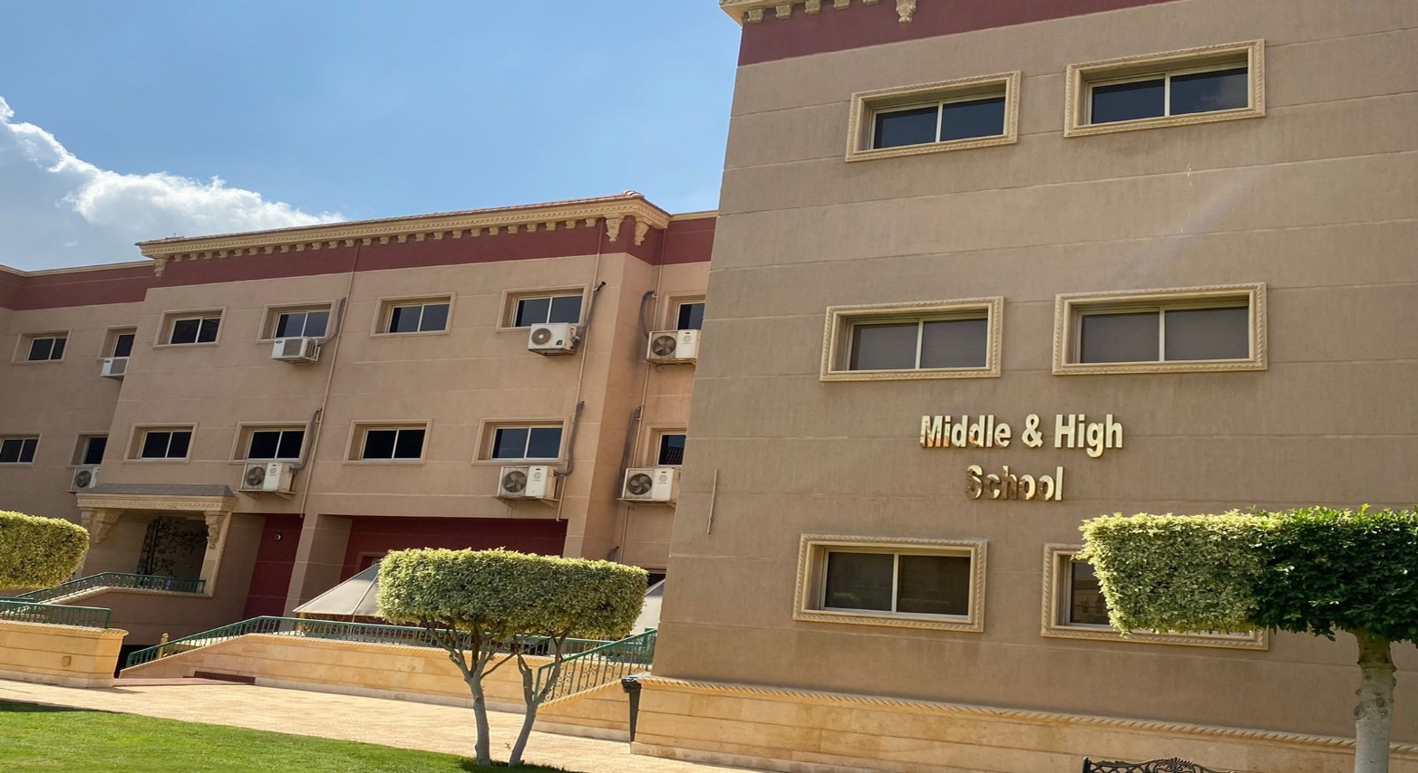
Grade 6 Orientation

Slide 2
“Education is not preparation for life; education is life itself.”
- John Dewey.

Slide 3
Our vision for our MS students
High Academic Standards
Creating and Promoting leadership
Global awareness
Character building

Slide 4
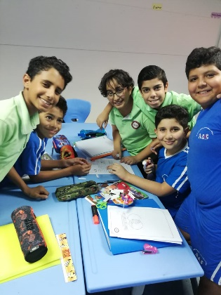
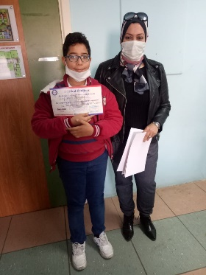
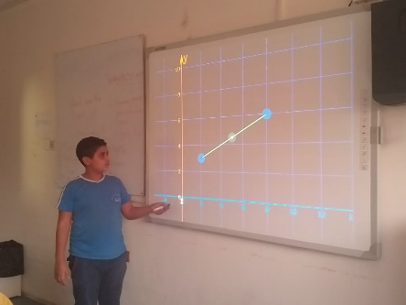
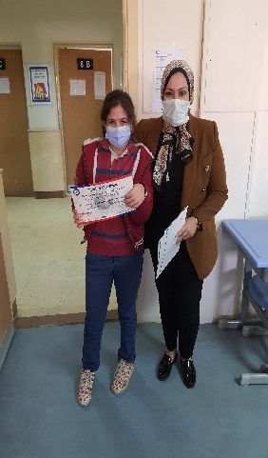
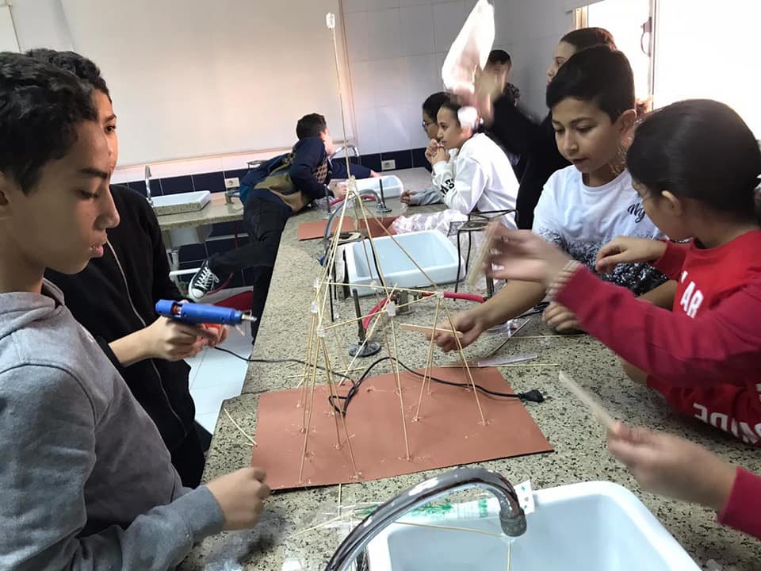
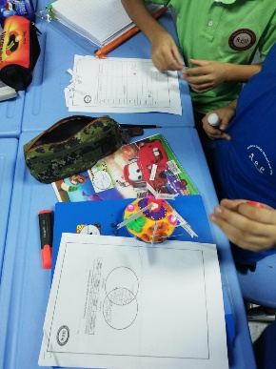
Our vision for our MS students
High Academic Standards
Promote understanding of academic content at high levels of proficiency
practicing problem solving and critical thinking skills within each subject

Slide 5
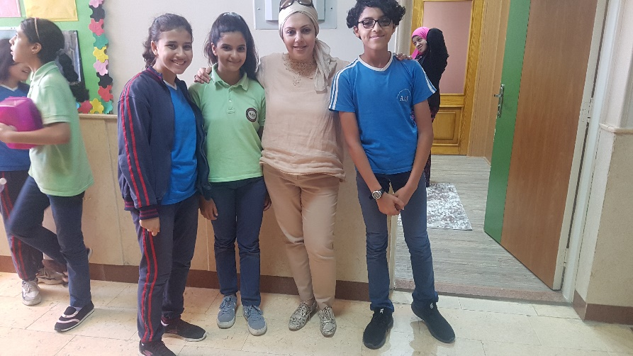
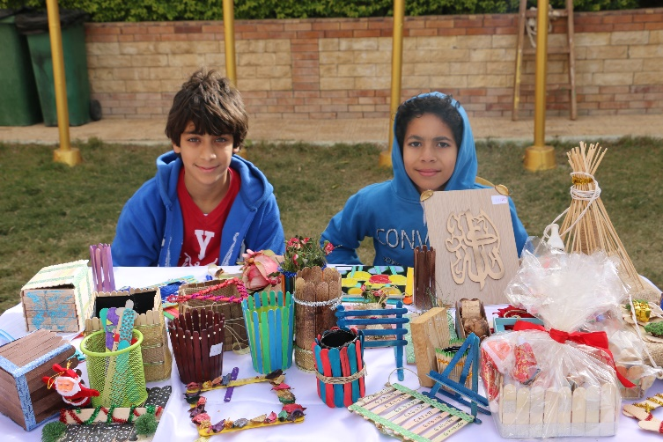
Our vision for our MS students
Creating and Promoting leadership
Through activities and opportunities both inside the classroom and across the middle school
The Middle School Student Council

Slide 6
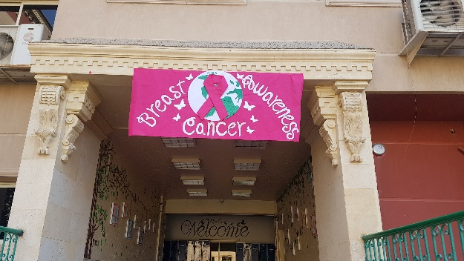
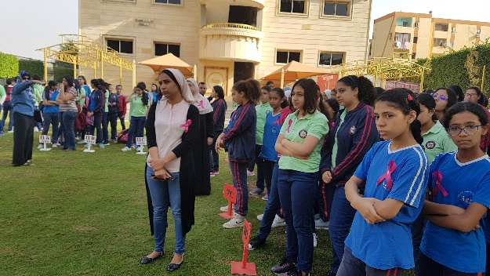
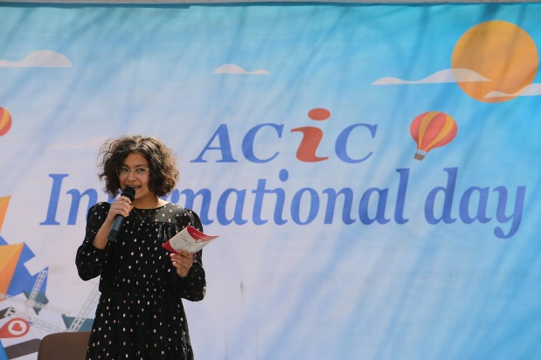
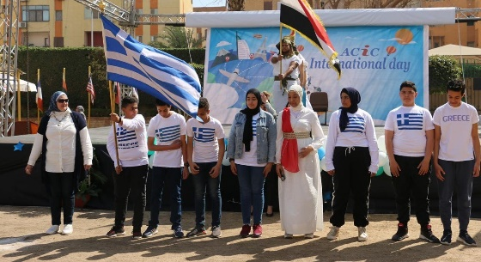
Our vision for our MS students
Global awareness
Addressing global issues across all subjects
Understanding diverse people and cultures

Slide 7
Our vision for our MS students
Character building
Through quarterly themes handled in different subjects
Religion classes which will emphasize good character traits

Slide 8
What to expect in MS?
SKOLERA LMS, Savvas and McGraw Hill platforms
Different scheme of assessment
Homework Policy
No co-teachers
Social interactions

Slide 9
What to expect in MS? SKOLERA LMS
The official LMS used in middle school is SKOLERA.
You can use it through:
www.acic.skoleralms.com or
The SKOLERA App from Play Store
Each parent and student have their own accounts with a username and password sent the first week of school

Slide 10
What to expect in MS? SKOLERA LMS
Check daily for announcements and messages from teachers
Each subject has it’s own page
Teachers upload daily work, assignments, announcements and material
Students and parents can communicate via ASK TEACHER

Slide 11
What to expect in MS? Different scheme of assessment
Multiple opportunities throughout 4 quarters to ensure the progress and success of our students
Eliminate subjective marks , all parts of the assessment scheme are evidence based ,60% of the students’ grades is assigned for quarter exams, 20% for quizzes, 10% homework and 10% project.

Slide 12
What to expect in MS? Homework Policy
To take full credit for homework it must be complete and submitted on time. A 1 day late submission is assigned 80% , a 2 day late homework is assigned 60%. Homework more than 2 days late is not accepted (assigned 0).

Slide 13
What to expect in MS?
No co-teachers
Students become self dependent and responsible for books, assignments and due dates
Social interactions
Students are expected to interact respectfully with peers, older students and adults
Student accountability

Slide 14
“What we want is to see the child in pursuit of knowledge, and not knowledge in pursuit of the child.”
- George Bernard Shaw.

Slide 15
Communication….. and follow-up
SKOLERA LMS
Communicating with teachers can be done through “Ask teacher” in the course page on SKOLERA
School email
Communicating with the Middle School office
01202088018
Communicating with the Middle School Principal
Email : lobna@acic.edu.eg
Calls everyday between 10-12
Schedule a meeting

Slide 16
Communication….. and follow-up
Video tutorials can be found on the school website for how you can access SKOLERA.
A link for parent resources for the Savvas platform can be found on both the school website and SKOLERA.

